Slide 1
LAGI Willimantic
11 October, 2017
5:30-7:30 pm
Johnson Room, J. Eugene Smith Library
Eastern Connecticut State University

Slide 2
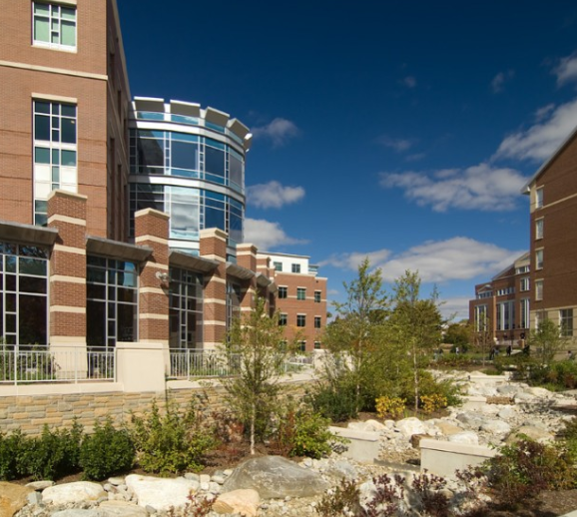
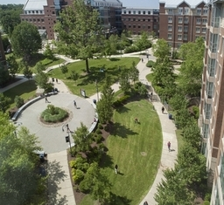
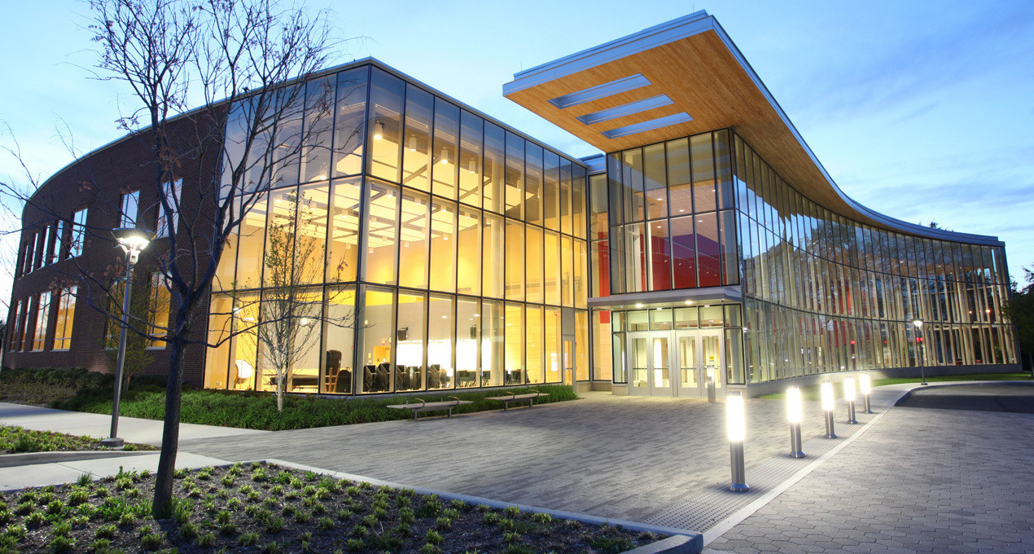
Welcome to Eastern!
Founded in 1889
5,362 enrolled (29 states, 74 countries)
State of CT’s public liberal arts university
Sustainable campus

Slide 3
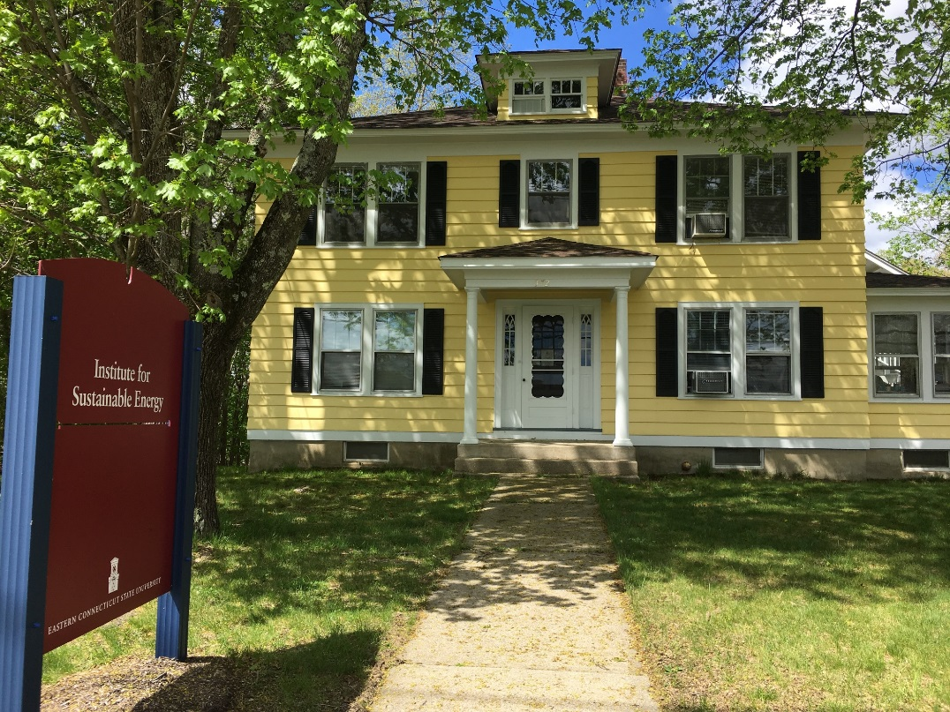
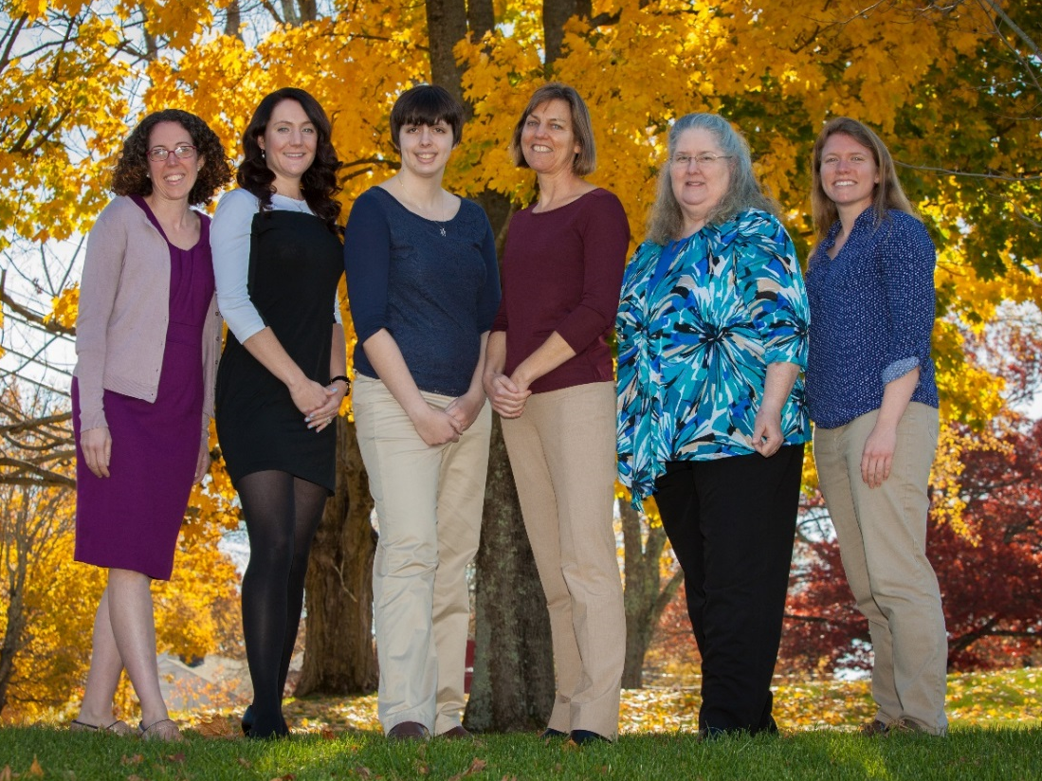
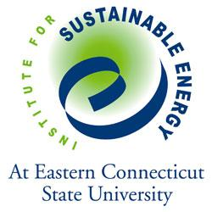
The Institute for Sustainable Energy
Mission: “To identify, develop and become an objective energy and educational resource regarding the means for achieving a sustainable energy future for Connecticut.”

Slide 4
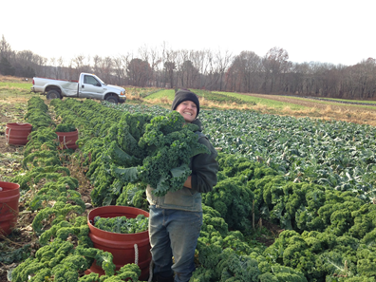
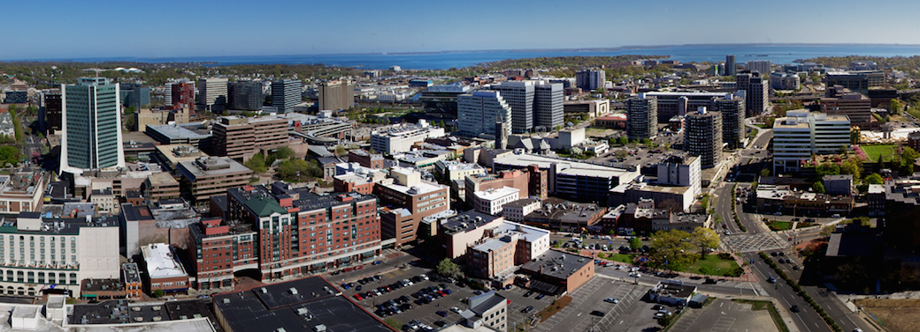
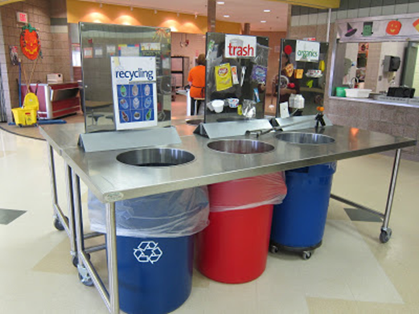
Sustainable CT: Vision and Program Framework
Road map. A menu of coordinated, voluntary actions to promote sustainability.
Resources. Support, including funding, to help municipalities implement actions.
Certification. To recognize municipalities for their sustainability achievements.
Flexibility. Meeting the needs of all municipalities, urban or rural, big or small.
Livability. More sustainable, efficient, healthy, safe, resilient, thriving municipalities.
Notes:
Sustainable CT communities strive to be: …thriving, resilient, collaborative, and forward-looking. They build community and local economy. They equitably promote the health and well-being of current and future residents. And they respect the finite capacity of the natural environment.
Initial partnership between ISE and Connecticut Conference of Municipalities
Generously supported by Emily Hall Tremaine Foundation, Common Sense Fund, and Hampshire Foundation

Slide 5
Thank you!
Questions? Contact us at:
Jessica LeClair
leclairj@easternct.edu
860-465-0258

